Slide 1
বাংলায় ক্যাগল প্রতিযোগিতা
হারুন-উর-রশিদ
Freelance Data Scientist,Kaggle
Linkedin: https://www.linkedin.com/in/harun-ur-rashid6647/

Slide 2
About me
Freelance Data Scientist in Kaggle
Writer, HackerNoon, Medium
Bachelor Computer Science and Engineering, Daffodil International University
Research Area: Machine learning, NLP,Deep learning.

Slide 3
Discussion: How to Join kaggle Compitetion & Hands-on Work
Create account
Join Competition
Hands-on work and submission

Slide 4
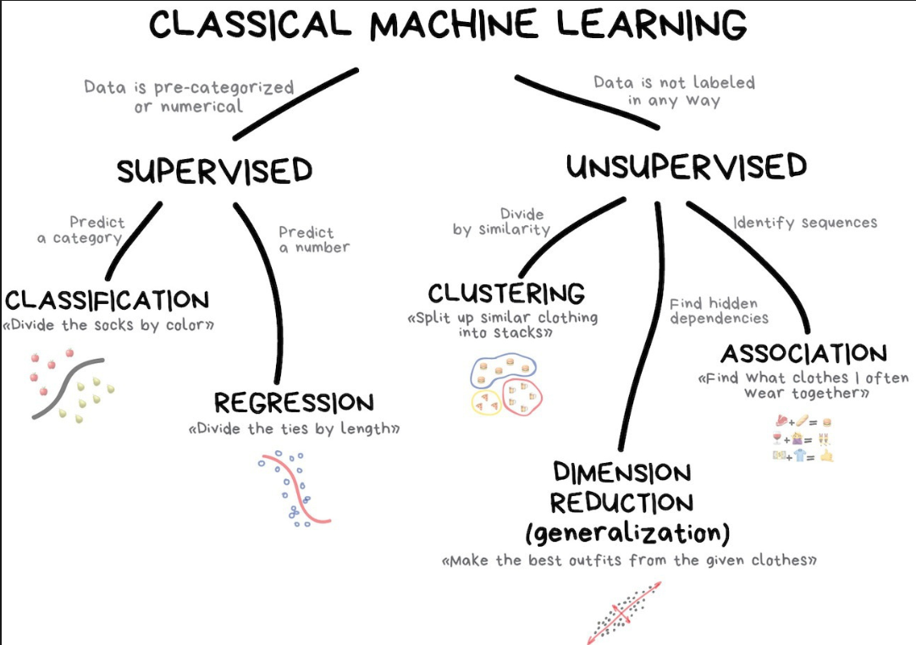
Classical Machine learning

Slide 5
Tools
o Python
o Pandas
o Numpy
o Scikit-sklearn

Slide 6
Hands-On Work
Titanic survival predictions beginner
https://www.kaggle.com/c/titanic

